Slide 1
“Tree Safe”
Sonograms for Trees
A simple non-invasive way to predict the structural integrity of trees.
Notes:
Tree Safe
The ability to predict which trees will fall on houses or power lines in the next storm will saves lives, property and money. This ability will save homeowners, town and city governments millions of dollars in repair and replacement costs plus lower insurance premiums. TreeSafe is a non-invasive technique that determines the viability of a tree that is infested with carpenter ants using acoustic waveform transformation algorithms, software application, database and a handheld computer such as a laptop, smart phone or tablet. With only 2 or 3 samples, this system can predict the degree of infestation with sufficient confidence that the homeowner, landscaper, power utility worker can decide if the tree is safe or not. No other commercially available system is this simple or efficient.

Slide 2
Hazard trees cost money
Estimated cost to take down 1 tree is $100 - $1,500.
Estimated cost of 1 tree falling on a house could be $1,000 - $200,000.
Trees falling on power lines start fires that destroy property and injure people.
A low probability event with high catastrophic outcome.
Notes:
Tree maintenance and removal can be expensive, especially if a tree falls on your house. The $200K estimate was for a house in Brentwood, CA. Trees fall on power lines and spark fires. Although this type of incident is low probability, the consequences are high.

Slide 3
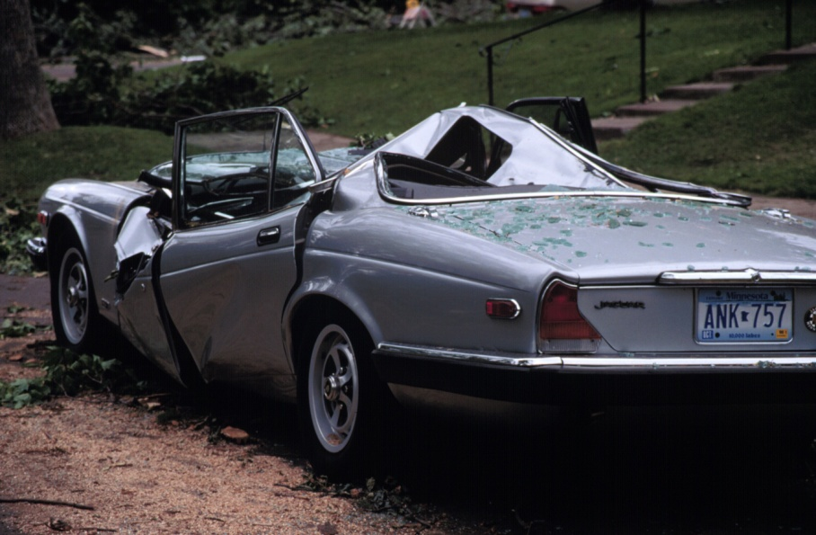
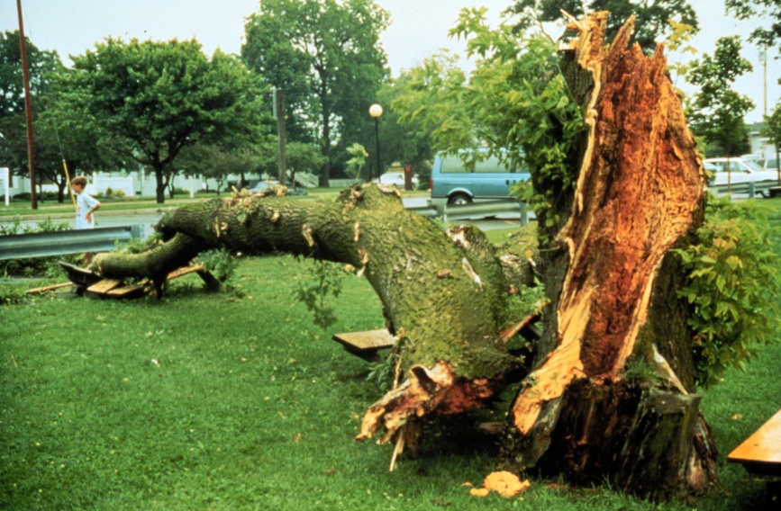
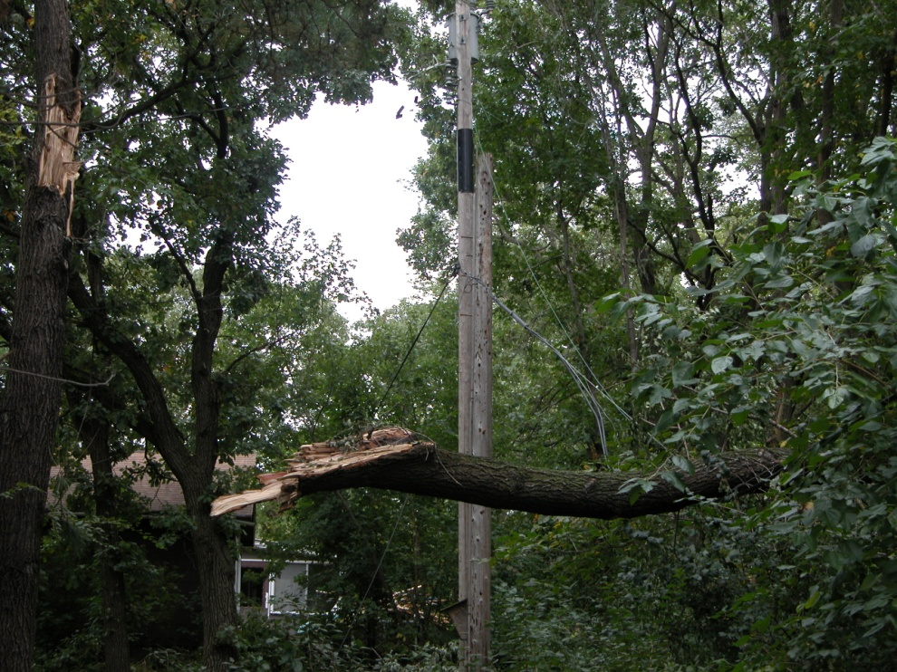
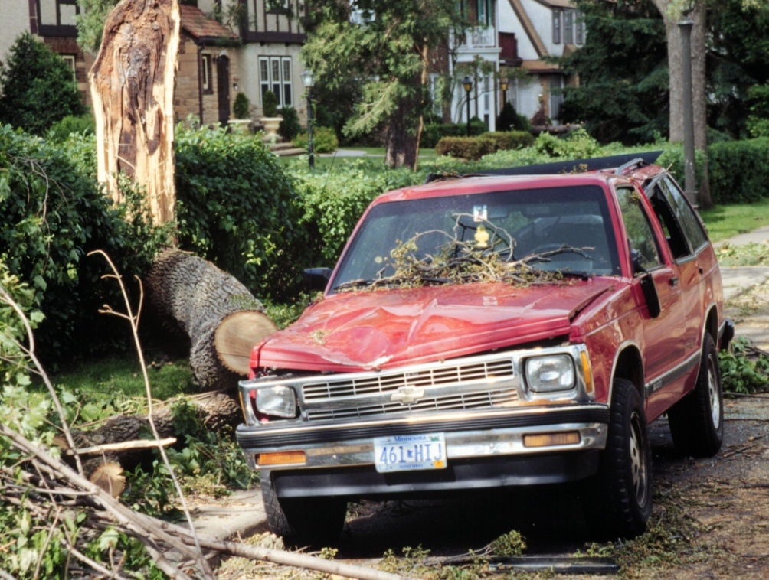
Hazard trees cost money
Notes:
Tree maintenance and removal can be expensive, especially if a tree falls on your house. The $200K estimate was for a house in Brentwood, CA. Trees fall on power lines and spark fires. Although this type of incident is low probability, the consequences are high.

Slide 4
Carpenter Ants - Cause or Effect?
Trees attacked by carpenter ants are usually under stress
The tree's primary problem is moisture or decay
The carpenter ants are not the cause of the tree's decline but an effect
They reduce the physical strength of the tree and quality of the wood.
Either way, the tree is in decline
Notes:
Carpenter ants are not the cause of tree decline, rather the effect of fungus or disease or excessive moisture or rot. They are opportunistic insects, merely seeking a low humidity protected environment to raise their young. So if you detect carpenter ants in a tree, then the probability is greater than zero that the tree is not healthy and is in slow decline. TreeSafe is a device that will tell you an estimated probability of that decline and how compromised the structural integrity really is.

Slide 5
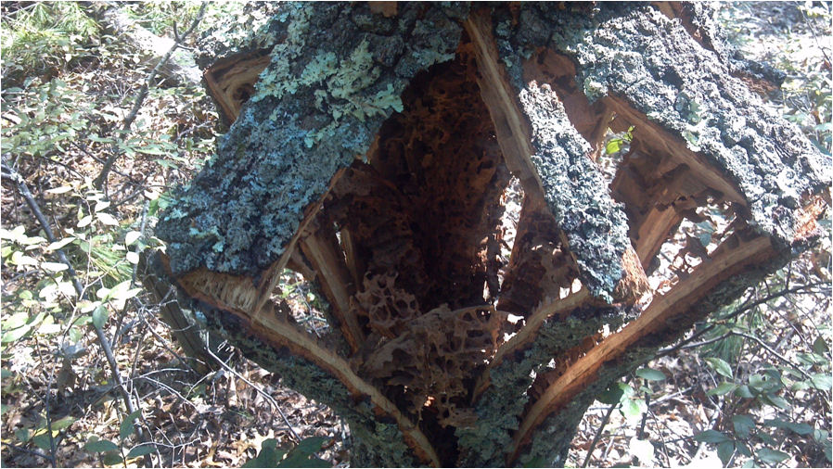
Carpenter ant galleries – 12 inch diameter oak – After Irene
This tree had no exterior indication of structural decay.
Typically, carpenter ants attack below the crown of the tree and build tunnels and galleries vertically.
Notes:
After Hurricane Irene, I walked through our neighborhood in West Kingston and took a walk through Crawley Reserve. I noticed that healthy trees were not damaged. The trees blown over and snapped at the base were hard wood oaks, not pines. Damaged pine trees were more likely to be snapped off more than half way up the base, not at the base.
Closer examination revealed that the oaks were compromised by massive infestations of carpenter ants. Yet, their external bark and limbs showed no signs of disease or rot or infestation. In other words, you could not tell by looking at the tree if it was compromised – likely to be blown over in the next wind storm or hurricane.
The Capstone Project I am proposing involves the following scientific disciplines: acoustics, material life sciences, mechanical and electrical design, computer science, and business. Here’s why. Literature and field research in life sciences is needed to discover how healthy trees differs from infested trees in terms of its acoustic signature, taking into account circumference, species, age, etc. There is some recent work in the ultrasound area. Engineering research is needed to determine the most economical mechanical and electrical device to deliver, analyze and record sonic impulses (much like sonar). I stress the word ‘economical’ because if the research shows there is a statistically significant difference between the acoustic signatures of healthy vs diseased trees, then this device and its associated acoustic algorithms and software can be licensed to commercial enterprises. Being able to predict the structural integrity of a tree will save millions in property damage and injuries. But it must be so simple that a utility worker, property owner, or landscape company worker can use it.

Slide 6
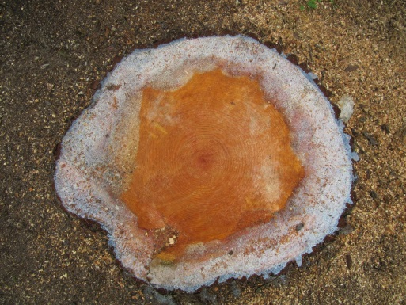
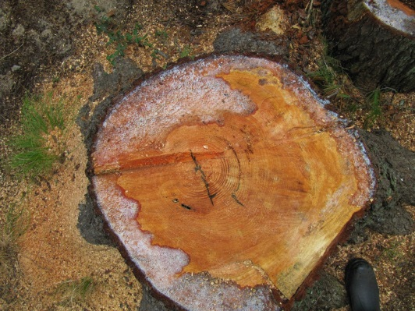
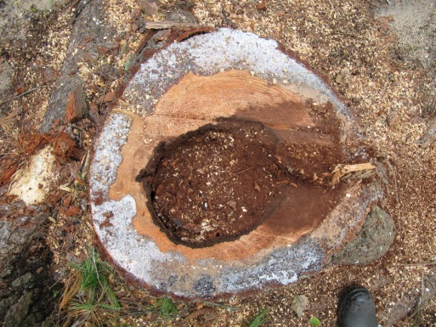
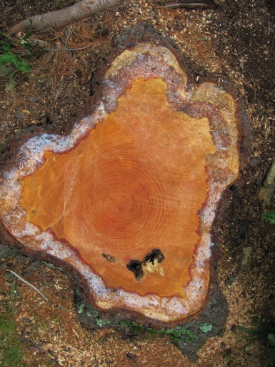
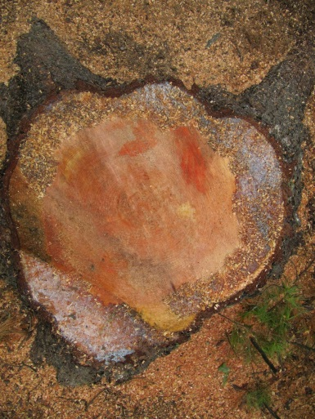
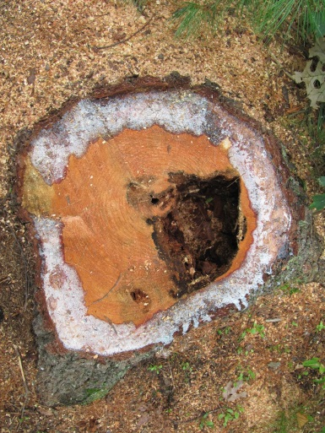
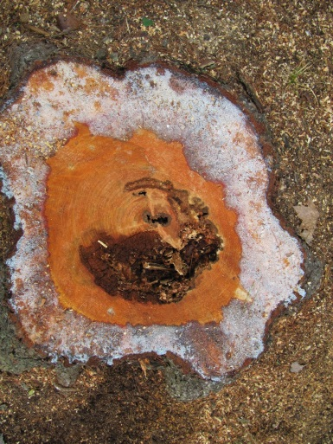
White Pine Stumps – Aug 2013
Which tree(s) do you think exhibited external indications of cavities or infestations?
1
2
3
4
5
6
7
Notes:
Number 1. It had been struck be lightning and had major carpenter ant infestation about 6 feet to 20 feet above the crown.

Slide 7
Current Decay (Disease) Detectors
‘Sounding’ – simple
  striking a tree with a mallet & listen for change in pitch
  tends to underestimate the extent of decay
  not refined enough to distinguish between sound wood and incipient decay
Chemical – complex
  Based on detecting acetic acid and other fatty acids
  Requires incremental coring
  Damages the tree, creating wounds in the bark and cambium.
Tomography – complex
  Ultrasonic
    Most promising method
    Measures signal Time Of Flight (TOF)
    Function of tree diameter & species
    Can inflict damaging wounds to tree
Notes:
Sounding is the simplest method that involves an experienced ‘listener’ (logger) smacking the side of a tree and making a decision about how sound the tree is based on the tone of the sound. But sounding is influenced by the thickness of the bark, the type of mallet, the experience of the listener – all variables. Which is not good science.

Slide 8
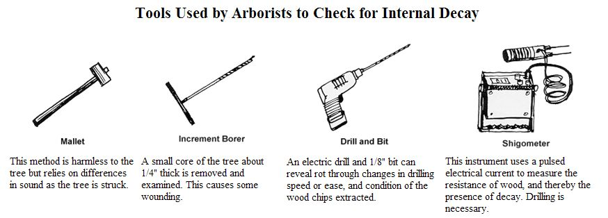
Current Methods
Most are invasive and damage the tree
Require multiple tools, techniques, and skills
“Not user friendly; not easily interpreted; no simple data acquisition and distribution.”
Notes:
Here are some of the tools that technicians use to determine the health of a tree. From extremely simple to very complex. They require drilling, coring, boring, interpreting complex data. Not recommended. We need something much less complex in terms of skills, hardware, damage to the tree, time, and personnel. Timber is a multimillion dollar business in New England.

Slide 9
Current Ultrasonic Discrimination
Waveform A shows the energy amplitude (volts) versus time (microseconds) for sound wood.
Waveform B shows advanced decay or a hole.
A
Amplitude
Time
B
Amplitude
Time
Notes:
Here are two of several types of graphs that depict waveforms based on different types of wood decay or cavities. The waveforms are different and current methods rely on an expert observer to discriminate what these waveforms mean in terms of tree structure. I believe this discrimination can be performed by algorithms, software applications, and cumulative knowledge collected by an online database. In other words, this system gets better with each diagnosis. It is not a standalone system but uses a knowledge base online and updated continuously. TreeSafe does the work of categorizing the decay.

Slide 10
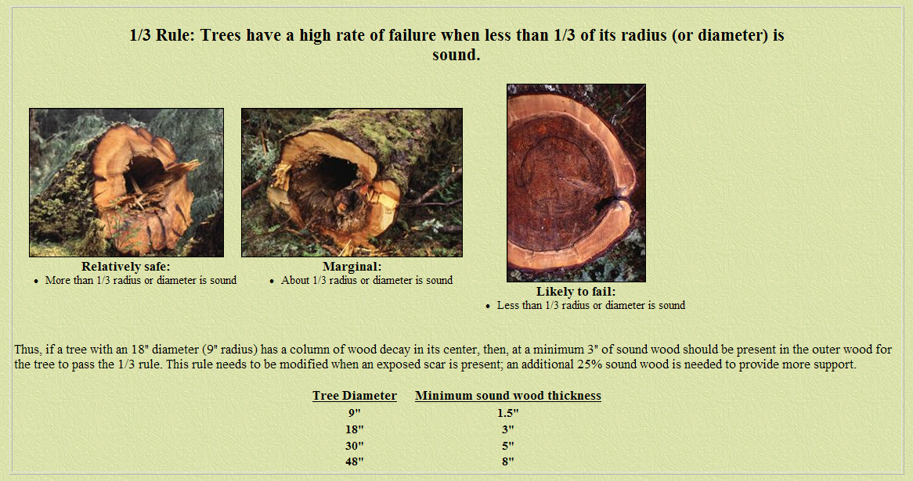
Some guidelines exist
Data available for the ‘1/3 Rule’
Notes:
There are some rules of the road to follow in categorizing decay. Here is the 1/3 rule. Maybe 4 categories are better. Tree Safe categorizes the decay based on the waveform analysis and provides the customer with a probability, like ‘25% decay’ or 75% decay. This quantifies the decay and lets the customer or user decide if they want to take down the tree based on the analysis and other factors like proximity to structures, power lines, etc.

Slide 11
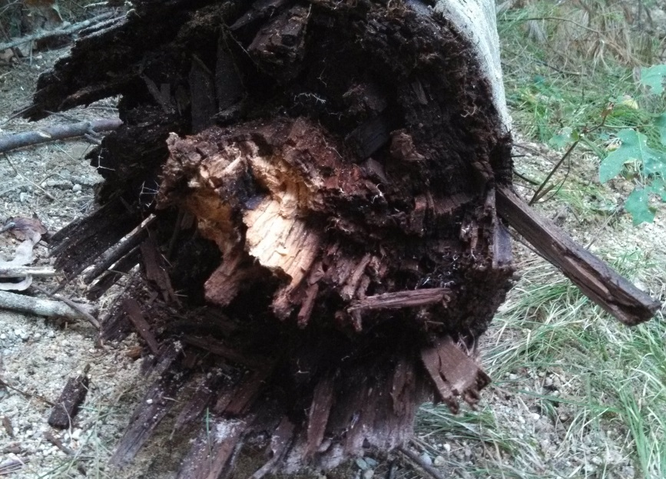
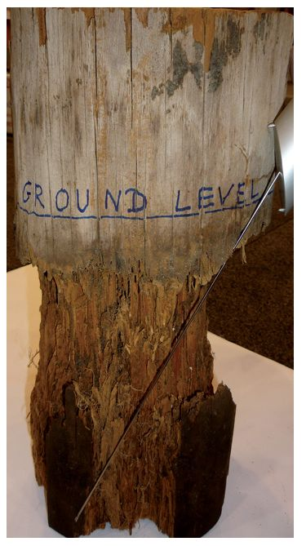
Telephone Pole – Sept 2013
Telephone pole replaced on Dug Way Bridge Road, Sept 2013
How often does a pole need to be inspected?
A wood pole line should be inspected initially after 15 to 20 years of service, depending upon the decay hazard where the poles are installed. Inspection of a wood pole line will normally consist of sounding the pole with a hammer in the above-ground areas, excavation around the pole for several feet below the ground line, inspection for external decay in the ground line area, boring to check for internal decay in the ground line area, removal of any decay on the exterior surface, treatment of any interior decay with a supplemental preservative, and wrapping the pole with a preservative wrap in the ground line area prior to backfilling.

Slide 12
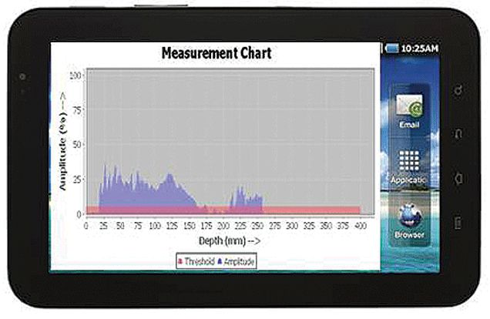
Current Methods – Telephone Poles
Article from “Utility Products” web site
Instrument Mechanik Labor GmbH (IML). Founded in 1985, IML invented the resistograph, a unit that was initially designed to assess the strength of trees and timber structures and expanded over time to include utility poles. European utilities have used the IML resistograph for more than 10 years.
The IML resistograph has three major advantages over the traditional manual excavate, bore and feel method:
1. Testing does not require excavation,
2. The drilling needle and measurement mechanism provide a nondestructive test, and
3. The unit produces a digital profile of the pole's internal condition.
The resistograph uses a drilling needle to create a small 1/8-inch channel to measure and record the wood condition above and below ground level, providing the inspected pole's exact density measurements on a scale of 1:1. The measurements are stored in an electronic unit for review and download through the integrated wireless Bluetooth adapter.

Slide 13
Current Methods – Telephone Poles
Article from “Utility Products” web site
While collecting and downloading the measurement data in a nondestructive manner is critically important, results analyses in a non-subjective manner is equally important.
A number of handheld units on the market can take field notes, mark global positioning system (GPS) locations, store photos and upload the information through central servers to create customer specific records.
Few handheld units, however, can analyze multiple drill profiles using a mechanized serviceability algorithm. Without that functionality, the inspector must look at each profile independently and make a judgment call about the compounded impact of the deterioration displayed on each drill profile as it relates to the pole's serviceability.
Results are automatically compared to Rural Utility Services (RUS) standards-or customer guidelines-to determine the proper serviceability category. They are displayed on the inspector's handheld, allowing him to instantly identify poles requiring follow up action. In addition, the measurement graph profiles are matched with the visual pole inspection data, creating a comprehensive individual pole record that is uploaded to a customer-specific database with multiple data sorting options.

Slide 14
Proposal Problem Statement
Research and design a non-invasive, inexpensive, simple system that consists of…
A transducer to transmit the signal to…
A smart phone, tablet, or laptop…
And acoustic waveform analysis algorithm, software application and database…
To determine with reasonable degrees of certainty (1/3 rule or better)…
If a tree is infested with carpenter ants…
Without requiring complex image or acoustic signal interpretation…
And both display and transmit information (3D view, cavity dimensions, location, etc.) to the user(s).
Notes:
Here is a synopsis of the PRIME problem. Tree Safe uses COTS hardware (laptop, tablet, transducer), application specific software, ‘cloud’ database applications and storage, and wireless interface to compile the data and analysis into a form that is transmitted to the customer. No printouts required. No paperwork. Tree Safe does that for the user – all displayed in a fill in form and emailed to the customer at the site.

Slide 15
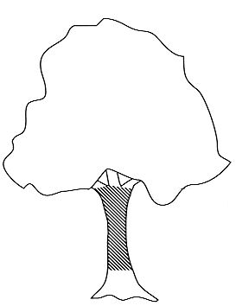
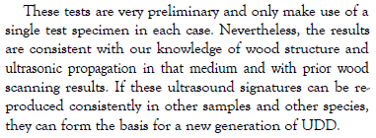
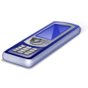
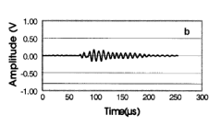
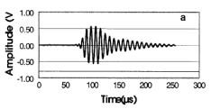
Notional System
Wireless upload / download
Report
Connector
S
Laptop
W
N
E
Cable
Transducer
Smart Phone
270
90
0
Impact Device
Smart Phone?
Band?
Flexible pole?
Wrap?
Tablet
Laptop, smart phone or tablet software analyze input, compare to online data base info and display results in PDF auto-fill form.
Tree Safe collects and formats GPS, photo, text, data and assessment for email PDF attachment to addressee.
Tree profile, photo, GPS data, impact device creates shock wave, transducer receives and transmits.
Notes:
Here is a notional Tree Safe system consisting of the impact device, the transducer (connected to a laptop or tablet via USB cable), hardware and software with wireless connection for sending the report to the customer email address. Customer might be a landscaper, utility company, home owner, insurance agent. The report contains a photo of the tree (taken by the smart phone or tablet), a GPS location, type of tree, dimensions, wave forms, comparison to similar trees, probability of detection and structural integrity.

Slide 16
Notional System Diagram
Analog Output
Energy Device
Pendant Weight
(Low Frequency)
Tree
A/D Converter
Transducer
Sensor (s)
Digital Output
Energy Device
Oscillator
(High Frequency)
E
N
S
Nkdsjfjdf
Ajjf ajdjaf
;ajfdjdfj
Ds djsfjdffff
Ddjdjf 343
33434 dfjd
ooertjpdp
Database
Algorithms
U / I Application
W

Slide 17
Notional System Architecture
HARDWARE
SOFTWARE
Tablet
Laptop
Smart Phone
User Interface
Transducer
Server SW
Cabling
Applications
Connectors
Algorithms
Impact
Device
Database
Notes:
Here is a notional system architecture for Tree Safe System. There are two segments in this notional system – hardware and software. Each is broken down further into subsystems (tablet, smartphone), components (cable, connector) or configuration items (database, applications).

Slide 18
Approach – First Semester
Form a team of students in mechanical and electrical engineering, computer science.
Determine system and subsystem requirements
Develop approach and system design
Develop software algorithms, application, and database architecture
Prototype user interface
Perform experiments with tree simulations
Enter WERC: A Consortium for Environmental Education and Technology Development design contest, NMSU, January 2014.
Notes:
We would use the design review process to research, design, test, and development Tree Safe. As a retired aerospace engineer, I would establish a systems engineering team to establish system and subsystem requirements, schedules, progress metrics, student mentoring, and hardware and software resource allocation. Year one is research, planning and system design; year two is development, prototyping and testing; year three is small scale manufacturing.

Slide 19
Approach – Second Semester
Validate and verify hardware and software.
Populate test database
  Tree type (deciduous vs evergreen), internal structure, diameter, height, proximity to utilities, cavity characteristics, etc.)
Perform field research with potential clients
  National Grid, landscape and tree removal company, US Forest Service, etc.
Refine models and algorithms
Iterate hardware and software design
Notes:
URI President David M. Dooley “Transformational Goals for the 21st Century”:
“One of our essential roles as the state’s flagship university is to work with the public and private sectors to create a vibrant and sustainable Rhode Island economy. We are uniquely positioned to increase the knowledge base through research, to convert new intellectual property into economic development, to establish jobs and small businesses, to produce business and industry leaders, and to provide critical expertise and innovative solutions to businesses, governments, and other who seek our assistance.”

Slide 20
What’s Next?
Develop requirements
  Mission
  Technical
Develop analyses
  Functional
  Task
  User
  Concept of Operations
  Trade off studies
Develop system architecture
Notes:
Other Technical Requirements may include:
Personnel and Training
Data
Quality Assurance
COTS/NDI
GFE/CFE

Slide 21
Mission Requirements
Define basic user needs and expectations related to system objectives, environment, constraints, measures of effectiveness.
Answers these questions:
  Operational: What is the operating timeline?
  Mission scenario: How will system accomplish objective?
  Information: What information (and data) is collected?
  Performance: What are critical system parameters to accomplish mission?
  Effectiveness: How efficient must system be in performing objectives?
  Life cycle: How long will user use system?
  Environment: What are environments where system is expected to operate effectively?

Slide 22
Technical Requirements
Technical
  Functional
  Performance
  Physical and Environmental
  Interface
  Modes and States
  Quality Characteristics
  Production
  Constraints
  Verification and Validation
Any unidentified technical requirement is a risk
Notes:
Other Technical Requirements may include:
Personnel and Training
Data
Quality Assurance
COTS/NDI
GFE/CFE

Slide 23
Technical System Level Requirements - Examples
The system shall measure tree diameter.
The system shall measure tree height.
The system shall identify tree type.
The system shall photograph the tree.
The system shall geo locate the tree.
The system shall display tree internal structure.
The system shall record user data.
The system shall be operated by one (1) person.
The system shall allow creating a user license to access the database.
The system shall display links to advertisers.

Slide 24
References
“Using Ultrasound to Detect Defects in Trees: Current Knowledge and Future Needs”; Leininger, Schmoldt, Tainter; 2001.
“Application and Comparison of 3 Tomographic Techniques for Detection of Decay in Trees”; Nicolotti, et.al,; 2003.
“Tree Defect Detection”, Skip Garrett.
“Diseases, Defects, and Structural Problems”, Manfred Mielke, 2007.
“Non-Destructive Testing (NDT) of Live Trees”, Lawrence Lawson, 2003.
Notes:
There is some recent research on this topic.
http://www.srs4702.forprod.vt.edu/pubsubj/pdf/01t34.pdf
http://waset.org/journals/waset/v2/v2-40.pdf

